Slide 1
Ayrian
Green Challenges site

Slide 2
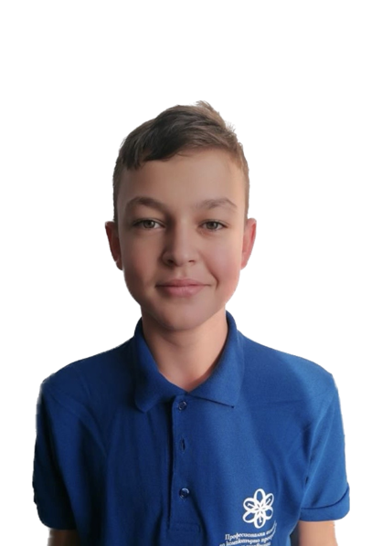
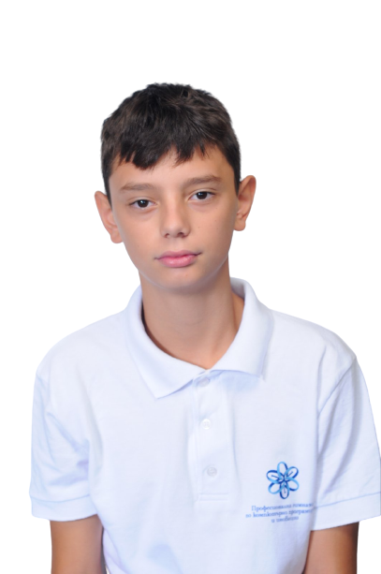
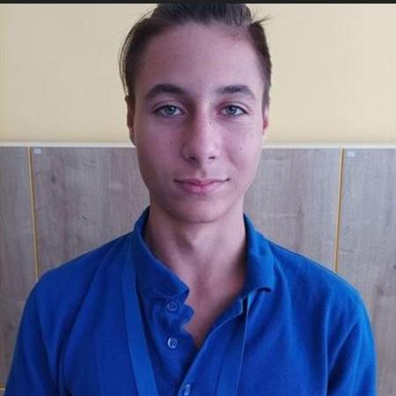
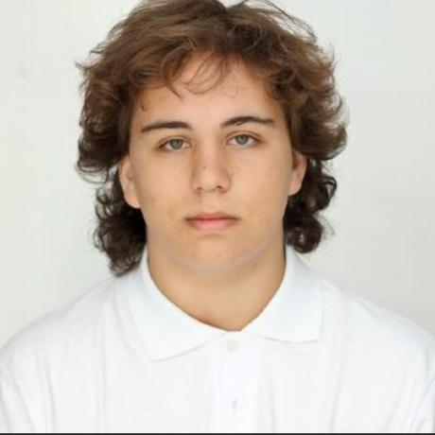
Our team
Scrum trainer
Asparuh Georgiev
Designer
Veselyn Naydenov
Front-end developer
Georgi Stoyanov
Front-end developer
Peter Kostov

Slide 3
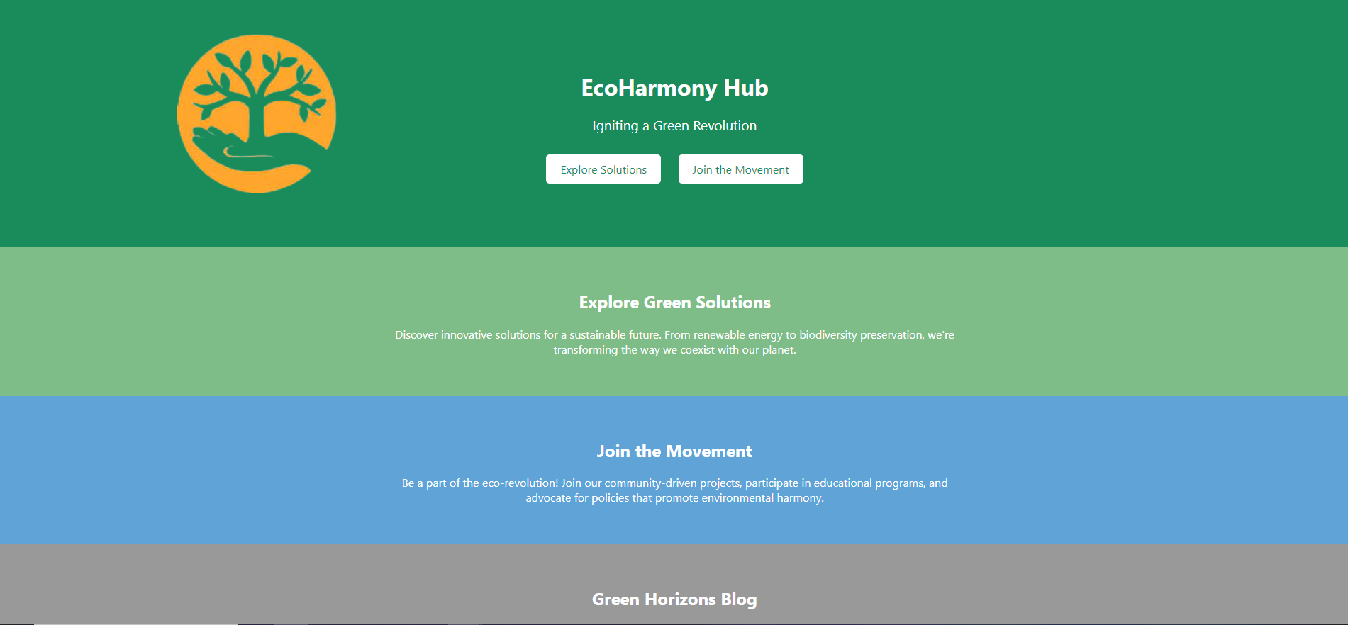
Our Idea
Our idea was to create a site about the Global Warming ,Water Conservation, Sustainable Agriculture

Slide 4






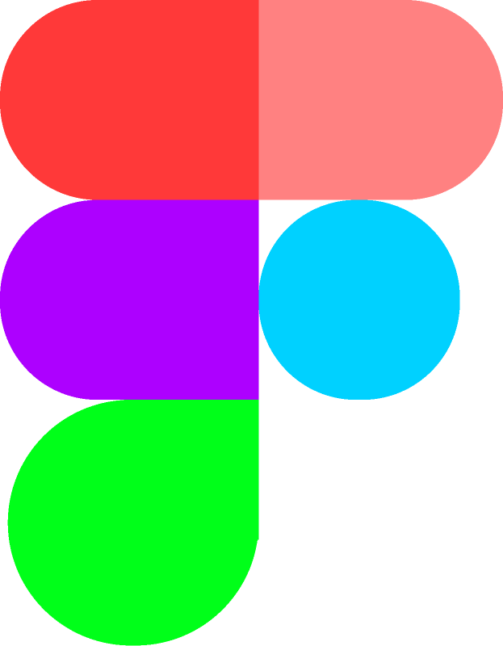

Tech used

Slide 5
Lets move on with our site.

